Slide 1
Time and Location profiles
Study based on kaggle data

Slide 2
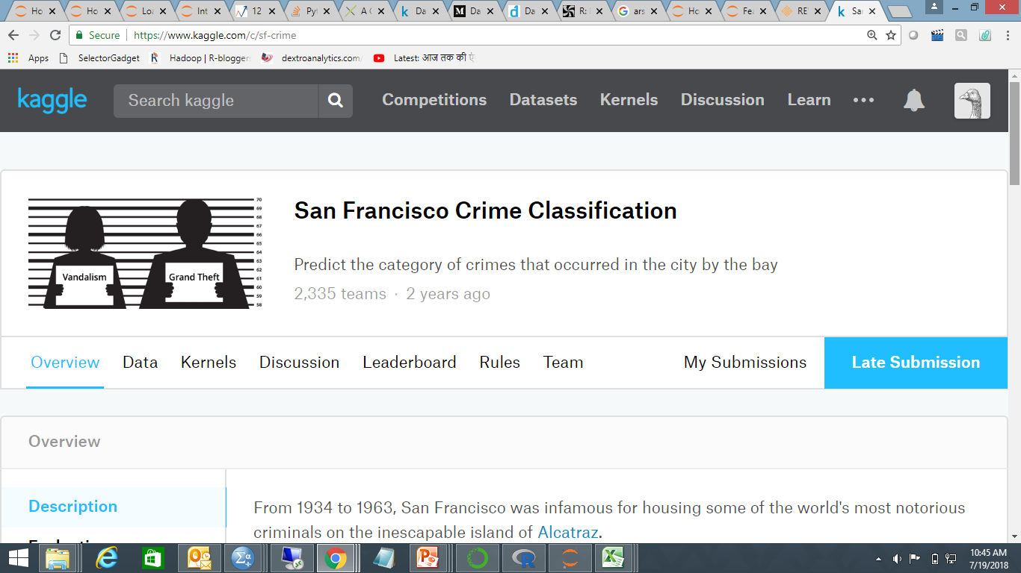

Slide 3
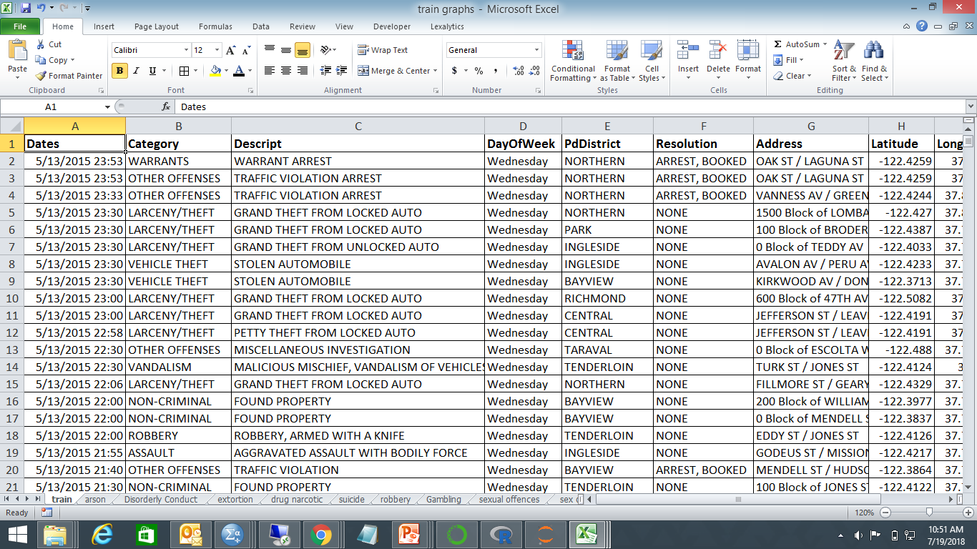

Slide 12
Profiling Darknet Sellers
Study based on kaggle data

Slide 13
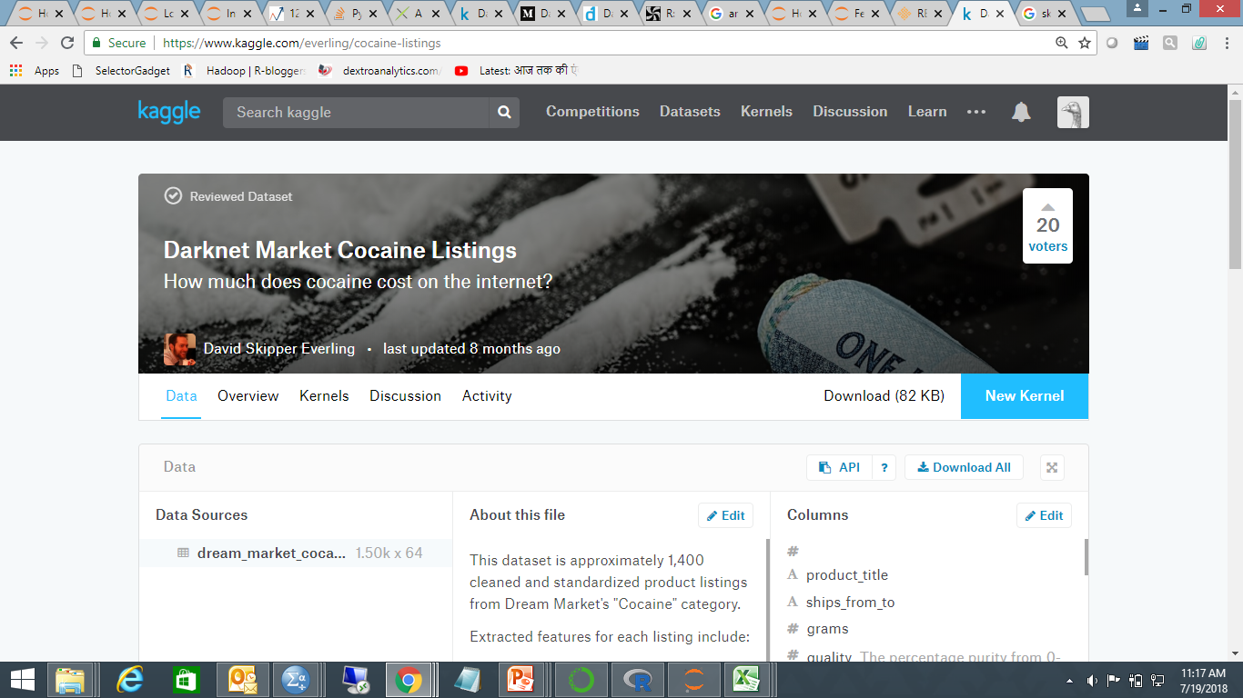

Slide 14
Background
This dataset is approximately 1,400 cleaned and standardized product listings from Dream Market's "Cocaine" category. It was collected with web scrapping and text extraction tehniques in July 2017
Features:
Product_title
ships_from_to
quantity in grams
quality
btc_price- Transaction done on bitcoin
vendor details
shipping dummy variables (true/false columns).
Additional information:
https://medium.com/thought-skipper/dark-market-regression-calculating-the-price-distribution-of-cocaine-from-market-listings-10aeff1e89e0

Slide 15
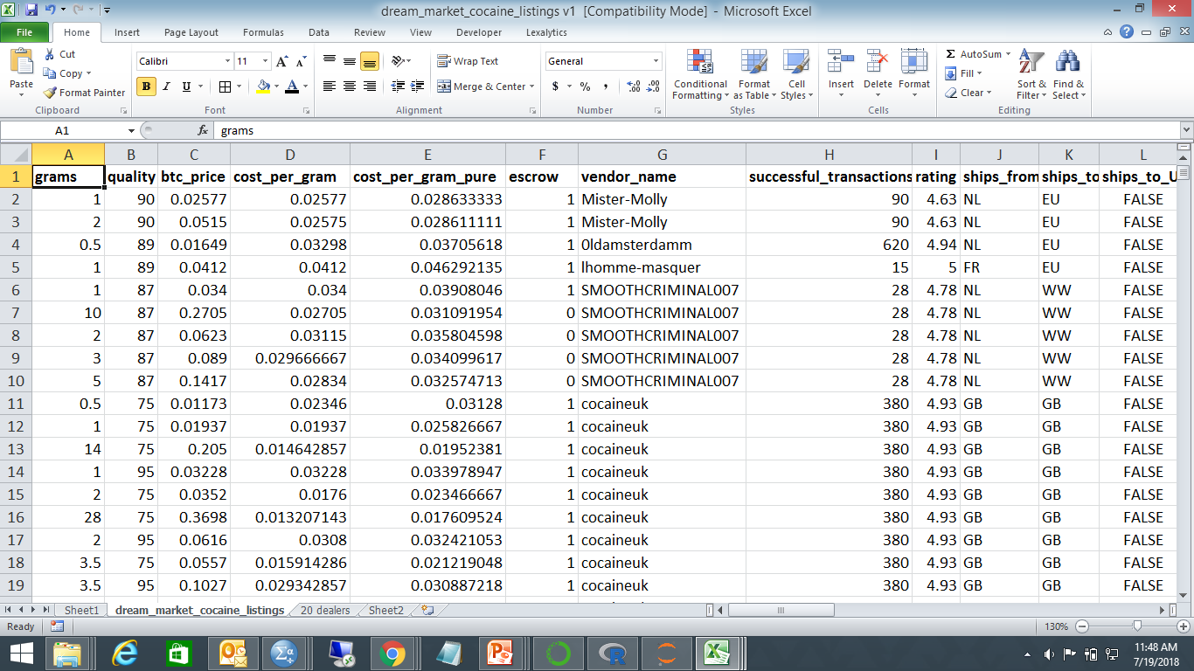
Data Snapshot

Slide 16
Who are the suppliers
 |  | Vendors
Vendor name | Frequency | Percent | Valid Percent | Cumulative Percent
0ldamsterdamm | 20 | 7.5 | 7.5 | 7.5
amsterdam2015 | 24 | 9 | 9 | 16.5
amsterdamflex | 20 | 7.5 | 7.5 | 24.1
Amsterdaminc | 5 | 1.9 | 1.9 | 25.9
CocaColaFR | 21 | 7.9 | 7.9 | 33.8
Gofastteam | 21 | 7.9 | 7.9 | 41.7
lafrenchconnection | 20 | 7.5 | 7.5 | 49.2
MedicsNL | 23 | 8.6 | 8.6 | 57.9
Mister-Molly | 20 | 7.5 | 7.5 | 65.4
Naturalminds | 23 | 8.6 | 8.6 | 74.1
pablopablito | 21 | 7.9 | 7.9 | 82
sky-high | 23 | 8.6 | 8.6 | 90.6
thebestchemist | 25 | 9.4 | 9.4 | 100

Slide 17
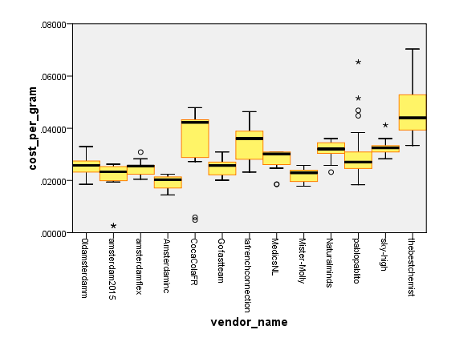
How do suppliers compare on cost?

Slide 18
Source of shipment

Slide 19
Destination of shipment

Slide 20
Average values
 | Grams | quality | cost_per_gram | successful_transactions
 | Average | Average | Average | Average
0ldamsterdamm | 121 | 89 | .02542 | 620
amsterdam2015 | 164 | 80 | .02131 | 620
amsterdamflex | 146 | 90 | .02459 | 180
Amsterdaminc | 335 | 84 | .01912 | 780
CocaColaFR | 48 | 90 | .03648 | 540
Gofastteam | 45 | 92 | .02475 | 3250
lafrenchconnection | 14 | 92 | .03459 | 260
MedicsNL | 78 | 84 | .02811 | 460
Mister-Molly | 134 | 90 | .02198 | 90
Naturalminds | 86 | 90 | .03195 | 490
pablopablito | 12 | 84 | .03148 | 230
sky-high | 16 | 90 | .03219 | 290
thebestchemist | 1 | 94 | .04729 | 980

Slide 21
Profile1
Supplier alias:The best chemist
Very small shipment quantities
Highest price and Highest quality
High price volatility
Ships from great britain
Ships worlwide as well as to EU

Slide 22
Decision tree

Slide 23
Profile2
Supplier alias: Gofastteam
Moderate shipping quantities
Low price
Highest number of transactions
Low price volatility
Ships from Germany
Ships to Germany
Ships worlwide as well to Germany

